Slide 1
Storage and Handling of Autocatalytic Exothermic Materials (AEM)
Sumeet Thete
Acknowledgement: Rajdeep Kalgutkar, Ninad Mhatre
Sumeet Thete, Corporate Research Process Lab, 3M, Maplewood, MN
Acknowledgement: Rajdeep Kalgutkar, Ninad Mhatre, David Hayes, Aaron Lindsey
May 2026
May 5, 2026

Slide 2
What are Autocatalytic Exothermic Materials (AEM)?
Industrially used as chemical blowing agents
Decompose upon heating to release gases
In a closed system, they can heat up and release gases leading to pressure buildup and therefore equipment failure or explosions
Maintaining appropriate temperature conditions during transport, storage, and handling is crucial to prevent premature reactions
Equation used to analyze the heat transfer associated with chemical reactions in AEM – Frank-Kamenetskii equation (will be referred to as FK equation in this presentation)
Objective: Identify the conditions required for the safe handling, storage, and transportation of AEM for the specified ambient conditions and material quantities
Autocatalytic – once the reaction is kicked off, it proceeds without much external help
Exothermic – as the reaction proceeds, energy is released

Slide 3
Concept of SADT: Self Accelerating Decomposition Temperature
SADT: a metric to determine the safe outside temperature below which the AEMs should be stored, handled, transported for safety reasons
If T_{A} < SADT, safe
If T_{A} > SADT, danger
Ambient temperature = T_{A}
Container with AEM

Slide 4
Concept of SADT – Self Accelerating Decomposition Temperature
SADT – A temperature threshold defining the maximum surrounding temperature below which AEMs can be safely stored, handled, and transported
If T_{A} < SADT, safe
If T_{A} > SADT, unsafe
T_{A}: Ambient temperature
AEM in a container

Slide 5
Experiment on AEM to determine SADT involves heating the sample in an oven and tracking the temperature variation with time
T_{oven} = T_{A} > T_{i}
T_{oven} = T_{A} > T_{i}
At later times
T_{i} = 10 C
T > T_{i}
AEM in a cylindrical container kept inside an oven
AEM is at a lower temperature than oven temperature
Track the variation of maximum temperature of AEM with time

Slide 6

If CE – CS < 7 days, then SADT = T_{A}, else repeat the test with T_{A} = T_{A} + 5 degree C
Max Temperature in AEM
= T in degree C
T = T_{A}+5
Ambient temp
in the oven = T_{A}
T = T_{A}-2
T = T_{i}
Time interval = CE - CS
Time
Clock Starts = CS
Clock Ends = CE

Slide 7
Limitations of the guidelines based on this test
SADT defines only an external temperature threshold for unsafe handling of AEMs.
It does not address the dynamic progression toward hazard once this threshold is exceeded.
It does not specify allowable response or intervention time after exceeding the SADT.
Current SDS does not account for container size or material mass.
The applicability of a single SADT across widely varying container sizes (e.g., 1 lb vs. 50 lb) remains unclear.

Slide 8
A comprehensive analysis is needed to bridge the critical knowledge gaps between Laboratory and Larger‑Scale AEM behavior
Lab settings
0.1 to 10 lbs,
0.1 to 3 gal
Diameter ≈ 2 to 10 inches,
Height ≈ 3 to 10 inches
Larger scale
100s lbs, 30 gal
Diameter ≈ 20 inches,
Height ≈ 25 inches

Slide 9
In this work, we rely on numerical simulations to estimate SADT, instead of conducting laboratory experiments

Slide 10
To perform numerical simulations, we will need following information
Governing equations
Simulation parameters
  Kinetic parameters
  Material properties
Simulation geometry
Problem setup
Lastly, we will look at the results

Slide 11
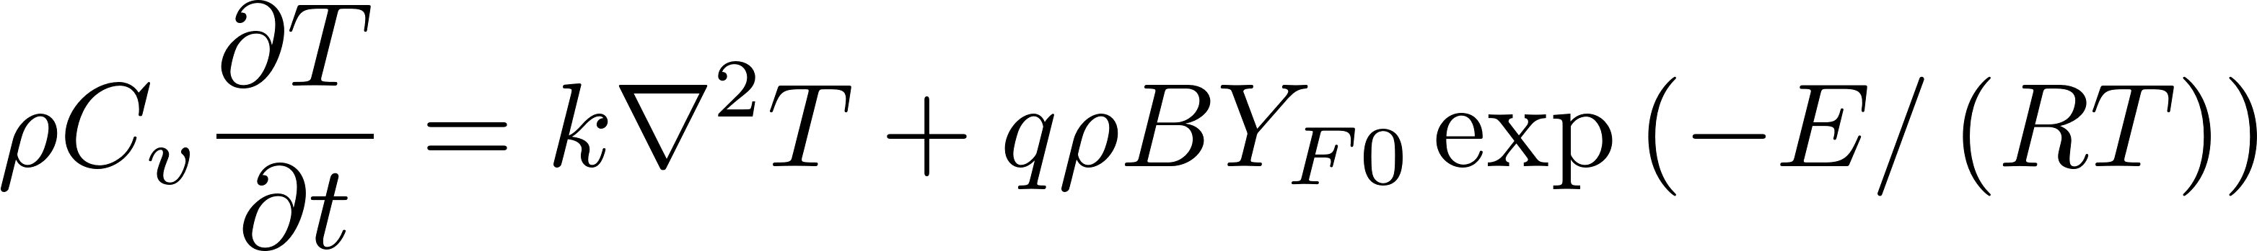
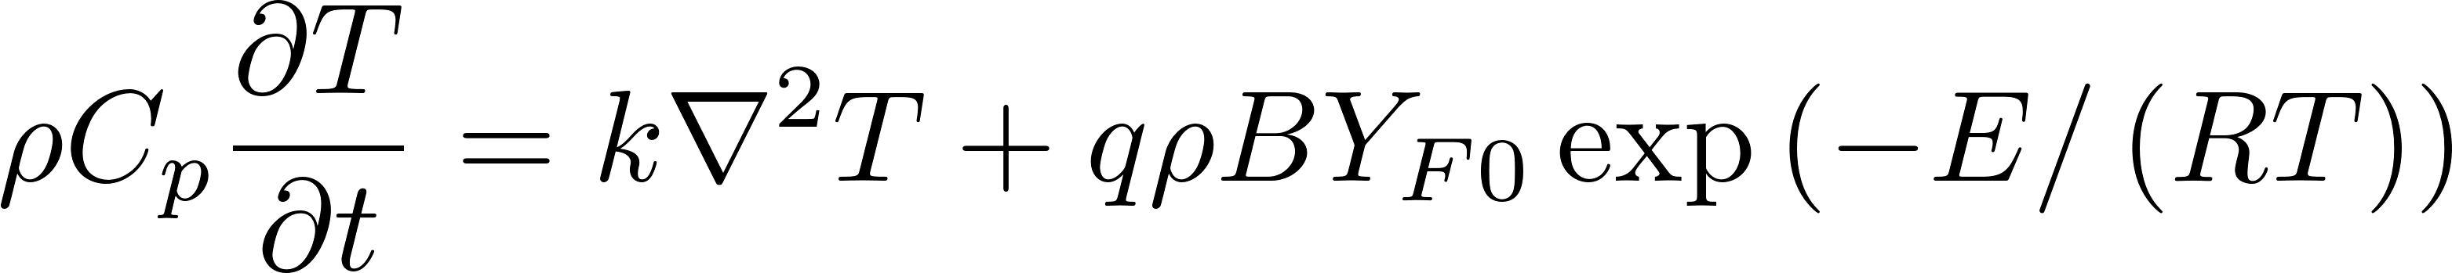
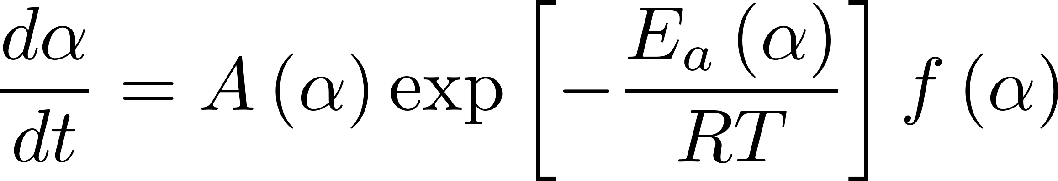
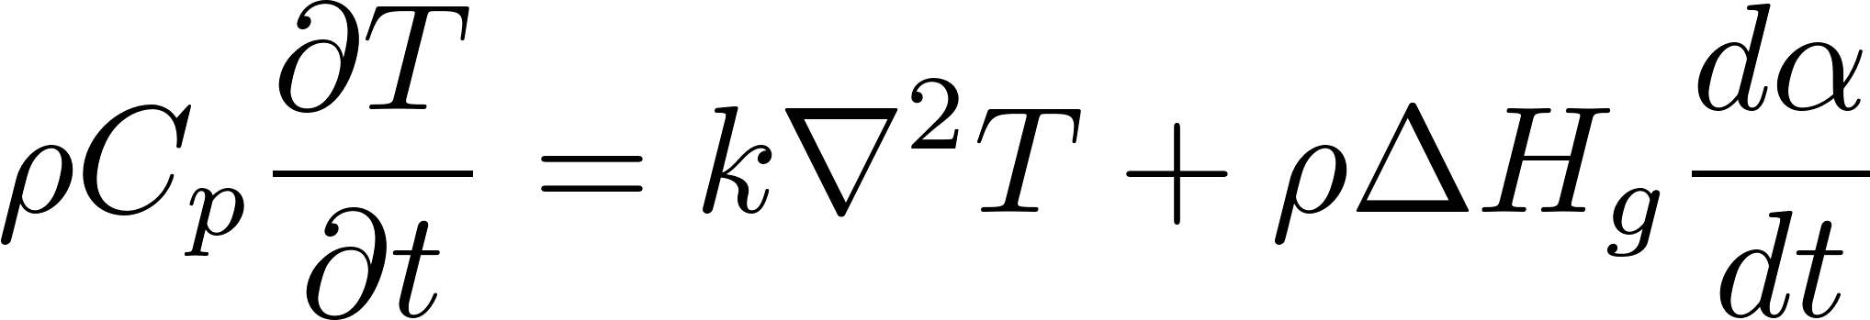
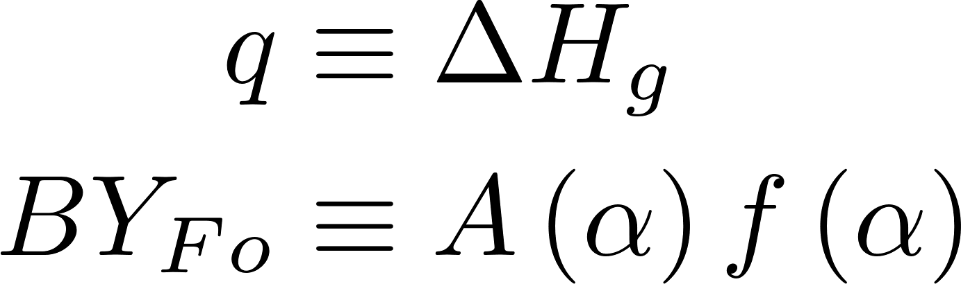
Energy release associated with AEM decomposition is typically studied in the literature using the Frank–Kamenetskii equation
From literature,
which can be decoupled into two equations
Kinetics equation
Energy equation
where,
Thus, to analyze the same problem, we can solve a coupled system of kinetics equation and energy equation

Slide 12
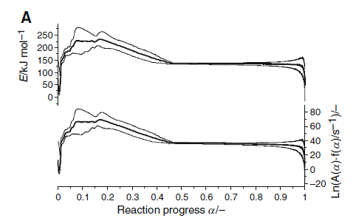
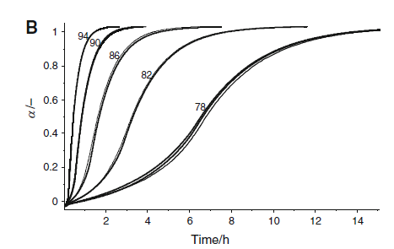
Since energy equation is generic, let us focus on kinetics equation and the data needed from experiments to estimate the relevant parameters
Differential Scanning Calorimetry (DSC) data provides the heat flow associated with decomposition, which can be integrated and normalized to obtain the degree of conversion (α) as a function of time, thereby enabling prediction of reaction progress under isothermal conditions.
Source: Figure 3(A) from Roduit et al. 2014
Roduit, B., Hartmann, M., Folly, P., Sarbach, A., Brodard, P. and Baltensperger, R., 2014. Determination of thermal hazard from DSC measurements. Investigation of self-accelerating decomposition temperature (SADT) of AEM 1. Journal of Thermal Analysis and Calorimetry, 117, pp.1017-1026.

Slide 13
Two problems can be seen with the kinetics equation from the literature
No meaningful insights can be drawn from the functional form
There is nothing in the equation
to cap the maximum value of α to 1
Plot shows “irregular” variation as opposed to a well-defined function such as parabola or exponential
We have a pre-factor and an activation energy vary with α. What does that physically mean?
Can we use this information to understand the early-time and late-stage behavior?

Slide 14
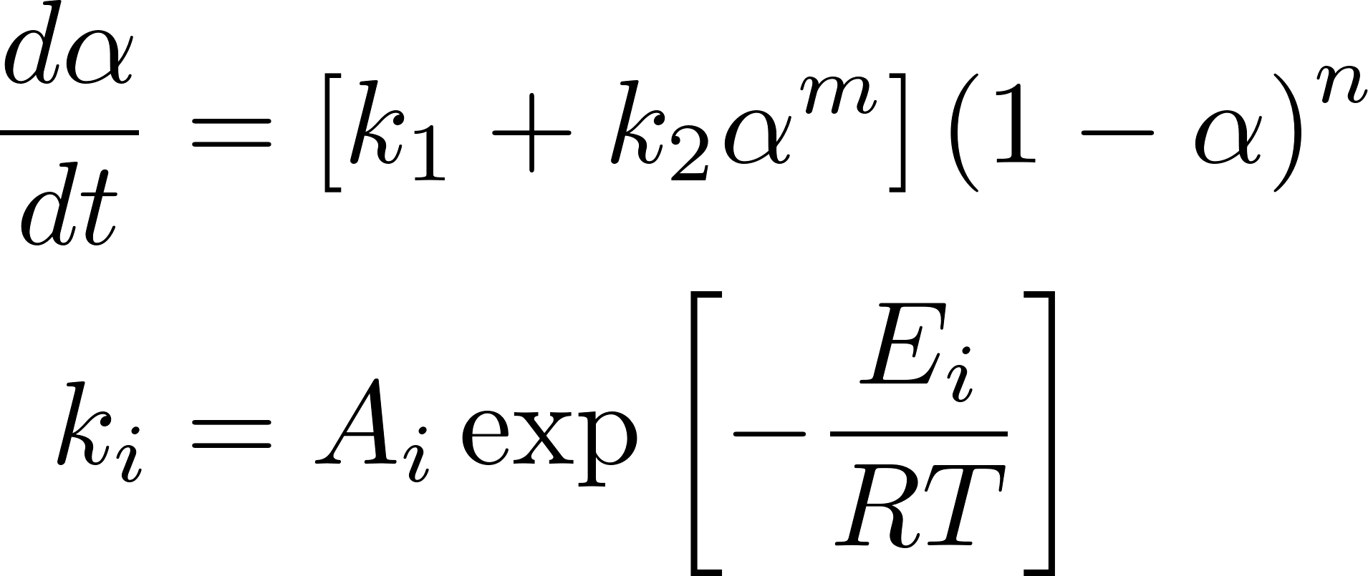
To circumvent this problem, let us introduce an Autocatalytic reaction equation proposed by Kamal to study the AEM kinetics
Equation was originally proposed to analyze the thermoset and epoxy cure
Unknowns = A₁, A₂, E₁, E₂, m, n
These can be obtained by fitting α vs. time curve
It can be clearly seen that this equation will not allow the value of α to go beyond 1
Functional form of the equation easily allows us to decouple the early time behavior with late-stage behavior helping us gain insights (see next slide for details)
Kamal, M.R. and Sourour, S., 1973. Kinetics and thermal characterization of
thermoset cure. Polymer Engineering & Science, 13(1), pp.59-64.

Slide 15
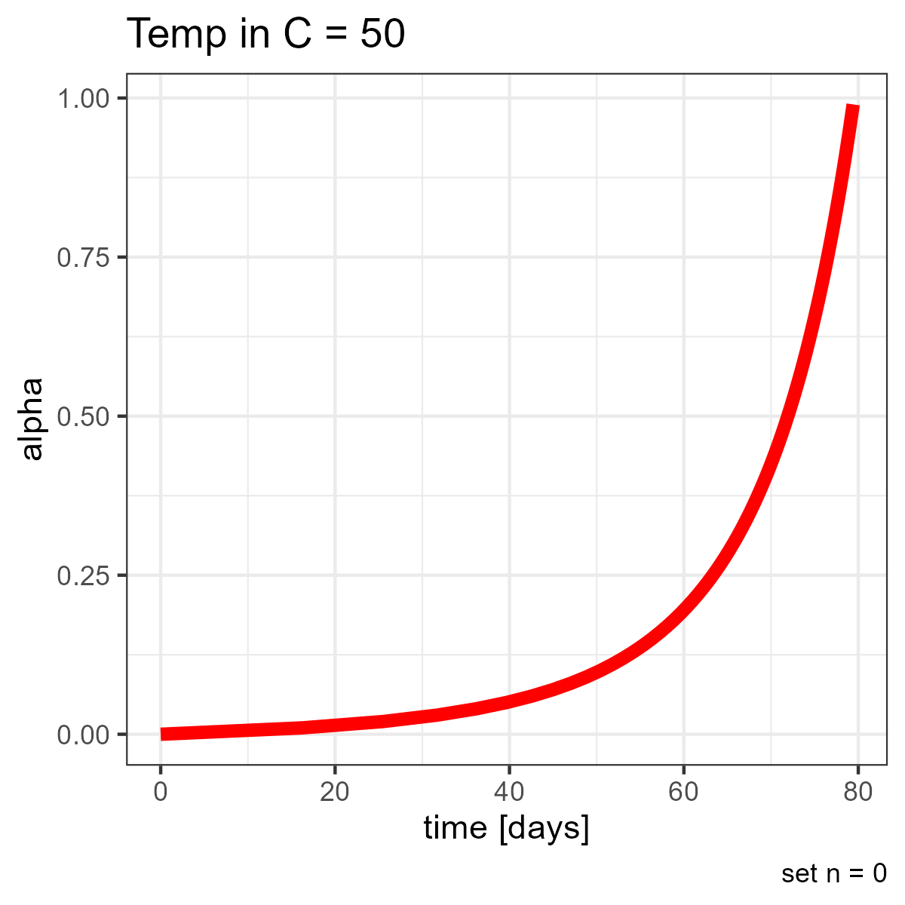
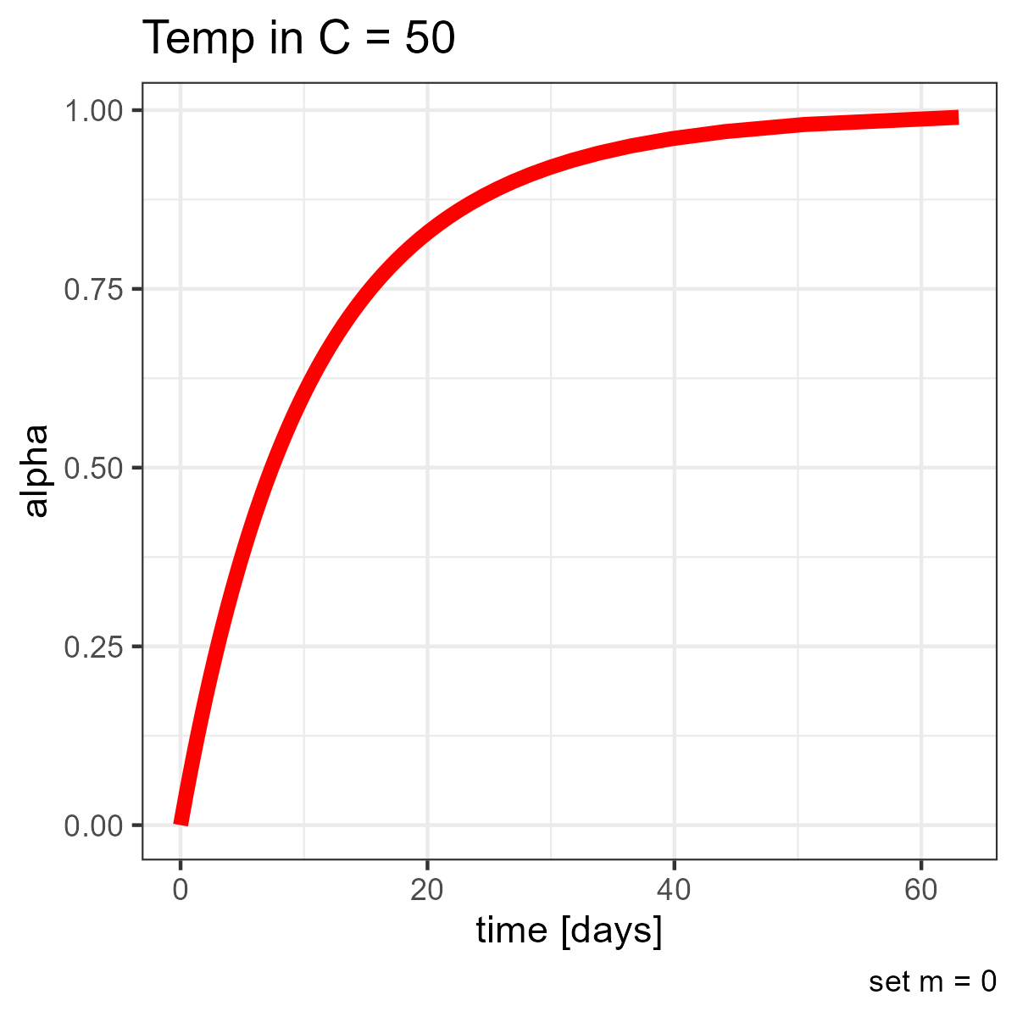
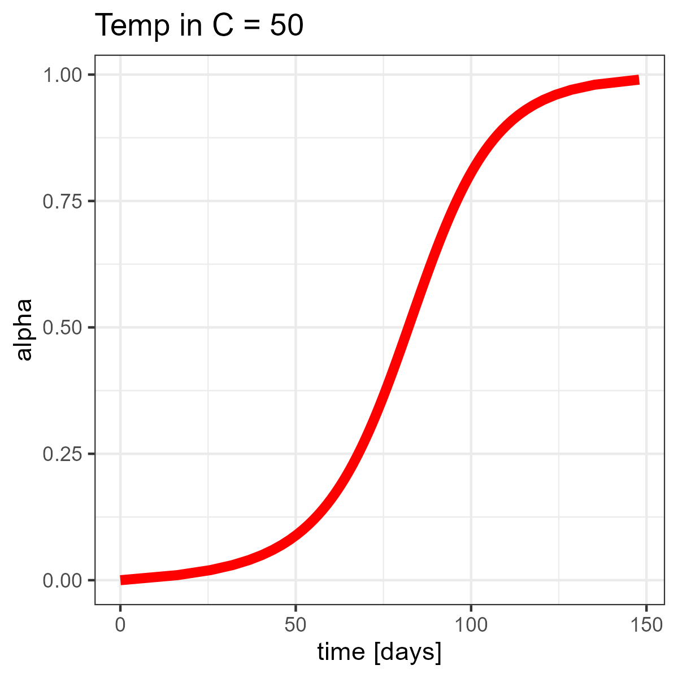
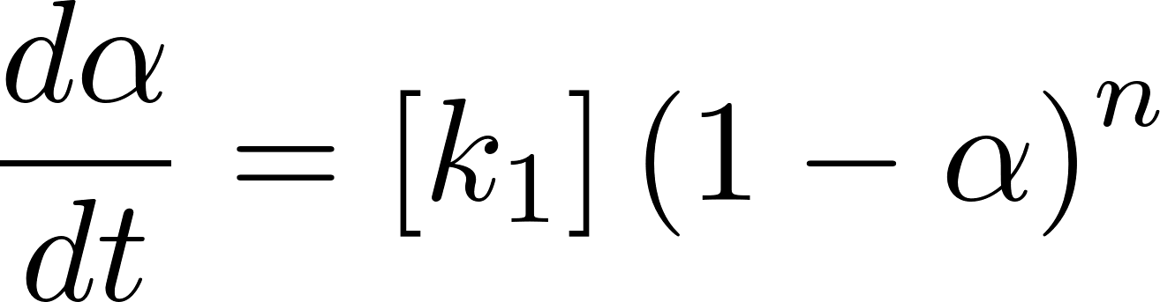
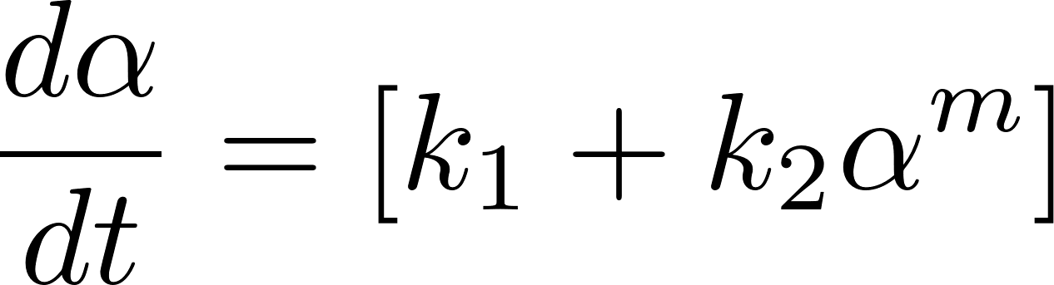
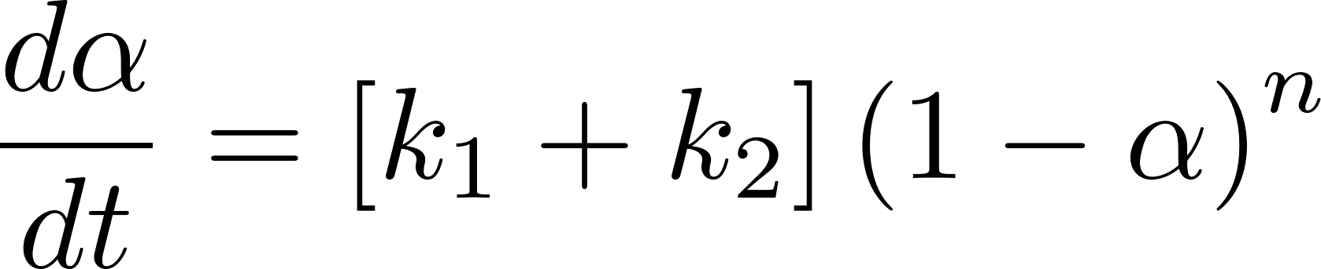
Early time behavior
is obtained by setting
Late time behavior
is obtained by setting
All time behavior
n = 0
m = 0 or k₂ = 0
Obtained by combining the two behaviors

Slide 16
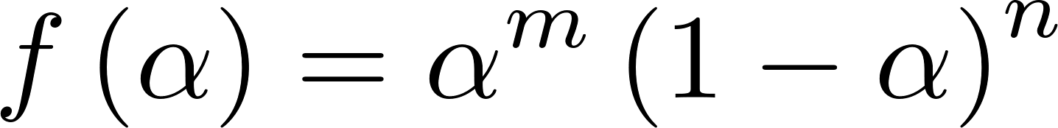
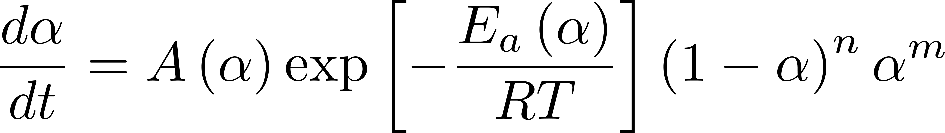
Note the equivalence between the literature equation and Kamal equation
Equation from the literature
Kamal equation
We will use Kamal equation to analyze the AEM kinetics
on account of the advantages discussed so far

Slide 17
In a nutshell, we will solve Kamal equation to simulate the kinetics and energy equation to simulate temperature behavior
Kinetics equation
Energy equation
To solve these equations, we will need material properties
such as reaction parameters and density, specific heat etc.
Let us start with reaction parameters

Slide 18
To perform numerical simulations, we will need following information
Governing equations
Simulation parameters
  Kinetic parameters
  Material properties
Simulation geometry
Problem setup
Lastly, we will look at the results

Slide 19
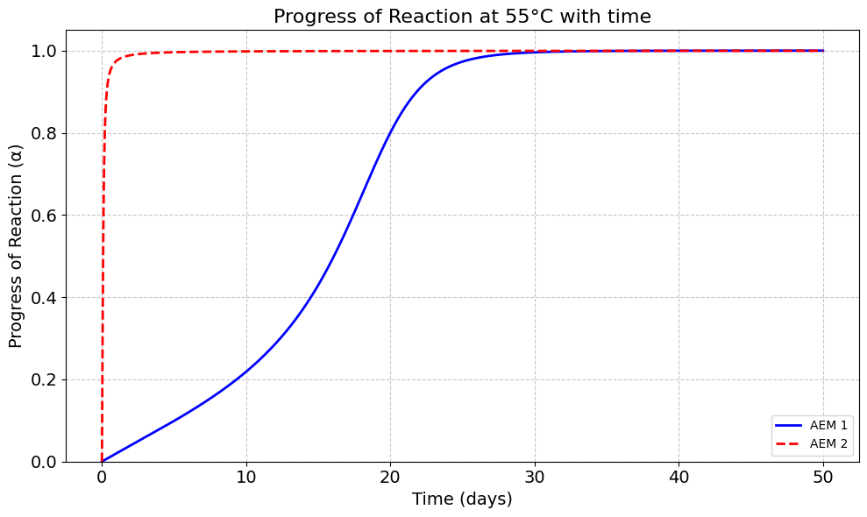
In this study, two AEMs of interest to 3M with distinctly different reaction kinetics — one fast and one slow — are selected for comparison.
The degree of conversion (α) ranges from 0 for completely unreacted material to 1 for fully decomposed material.
At 55 °C, AEM 1 decomposes slowly, requiring nearly 30 days to reach full conversion.
In contrast, AEM 2 decomposes rapidly, reaching near-complete conversion in less than 5 days at the same temperature.
Similar kinetic behavior is observed across other temperatures.

Slide 20
Kamal reaction kinetics parameters for both AEMs are determined by fitting the model to DSC measurements at different temperatures
AEM 1 (Slow kinetics)
AEM 2 (Fast kinetics)
Parameter | Units | Value
A₁ | 1/days | 8.24 × 10¹⁸
E₁ | J/mol | 129491
A₂ | 1/days | 5.64 × 10²⁸
E₂ | J/mol | 181686
m |  | 2.35
n |  | 1.13
Quantity | Unit | Value
A₁ | 1/days | 5.53 × 10⁵⁰
E₁ | J/mol | 313271.5
A₂ | 1/days | 7.8 × 10¹⁹
E₂ | J/mol | 115714.2
m |  | 1.565
n |  | 1.920

Slide 21
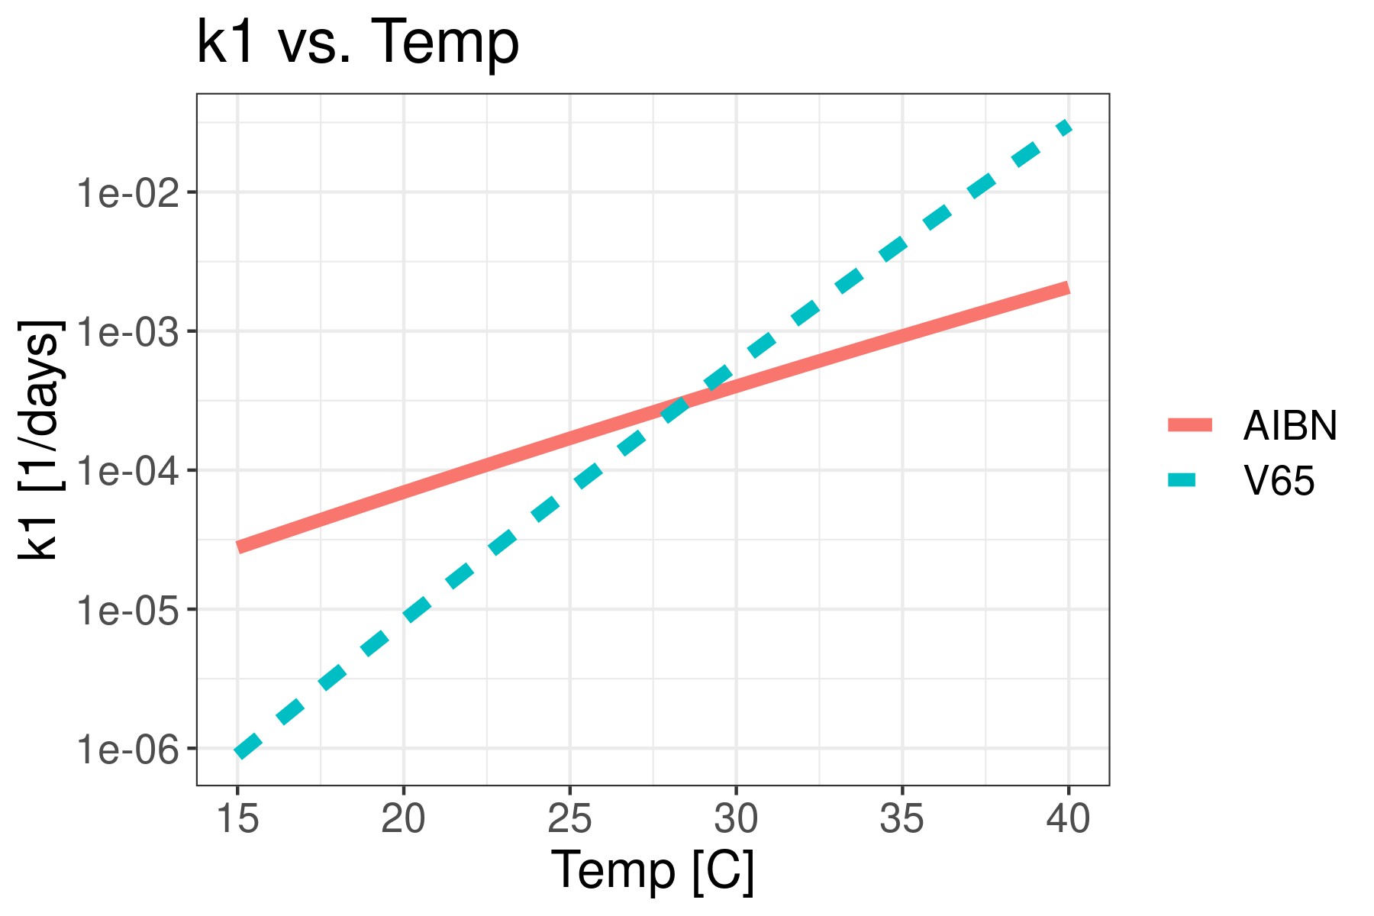
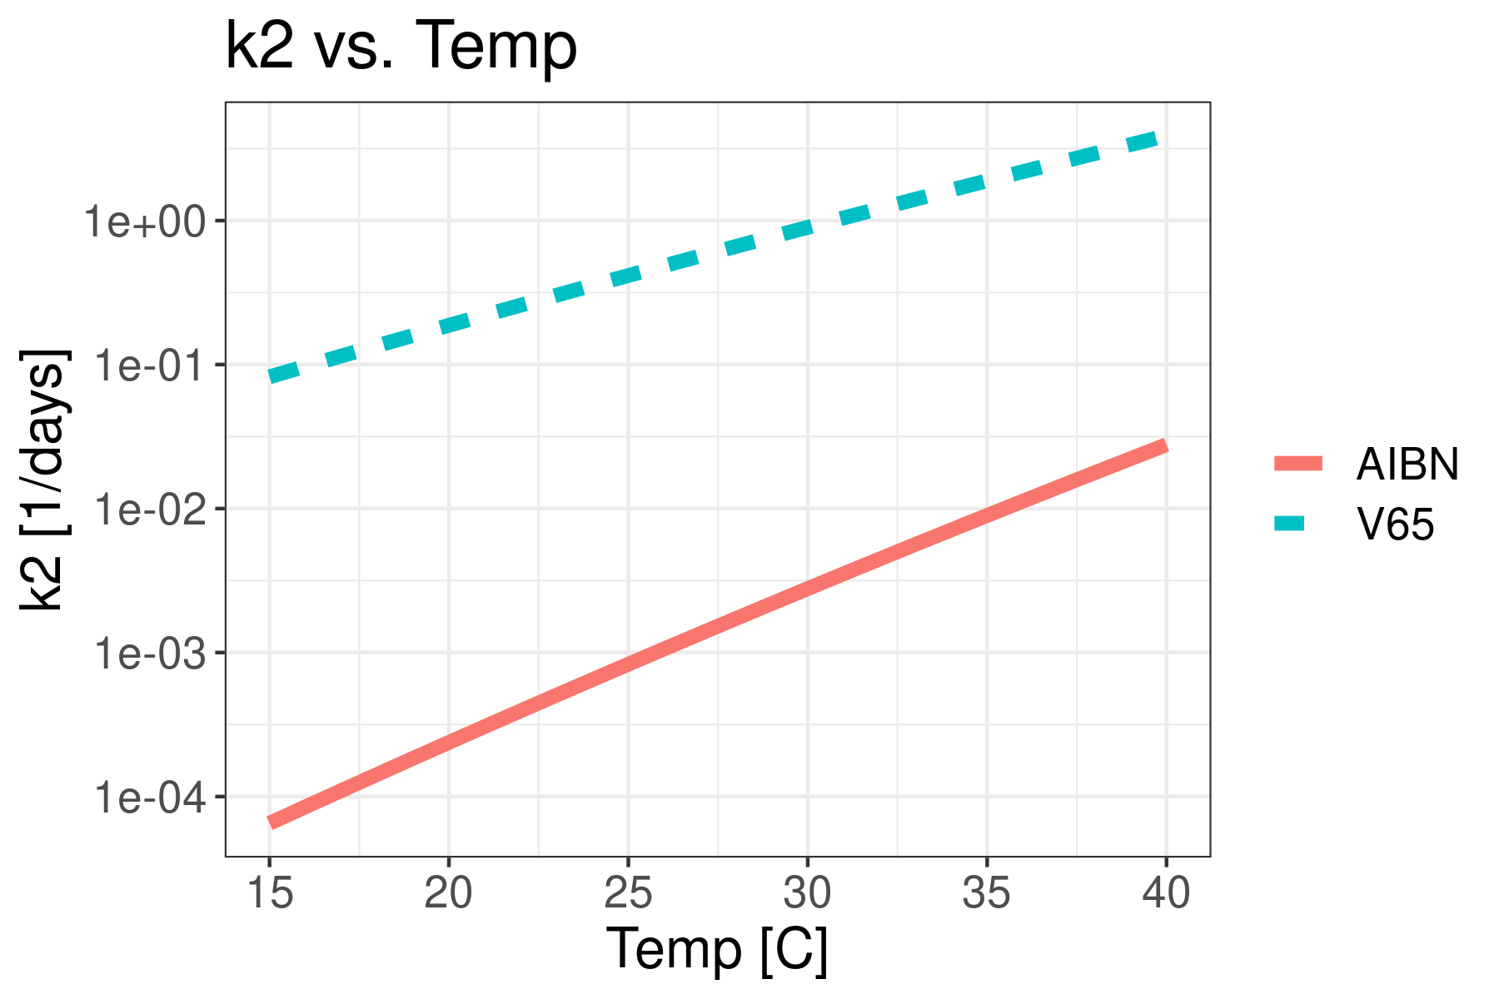
Given several orders of magnitude difference between A₁, A₂ values for the two materials, let us understand how k₁ and k₂ will vary with temperatures
AEM 2
AEM 1
Before approximately 27 C, k_{1, AEM 2} < k_{1, AEM 1}
At all temperatures, k_{2, AEM 2} > k_{2, AEM 1}
After approximately 27 C, k_{1, AEM 2} > k_{1, AEM 1}

Slide 22
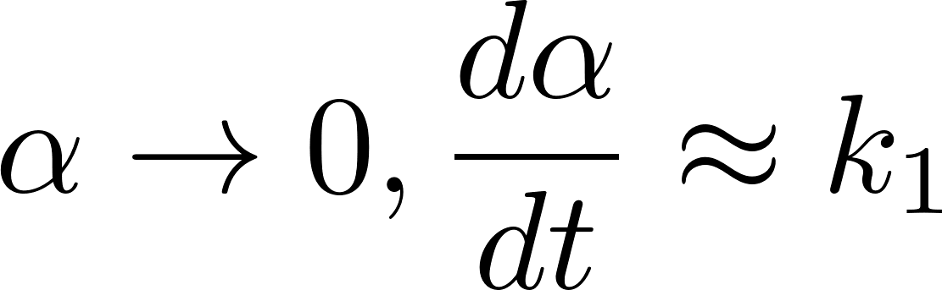
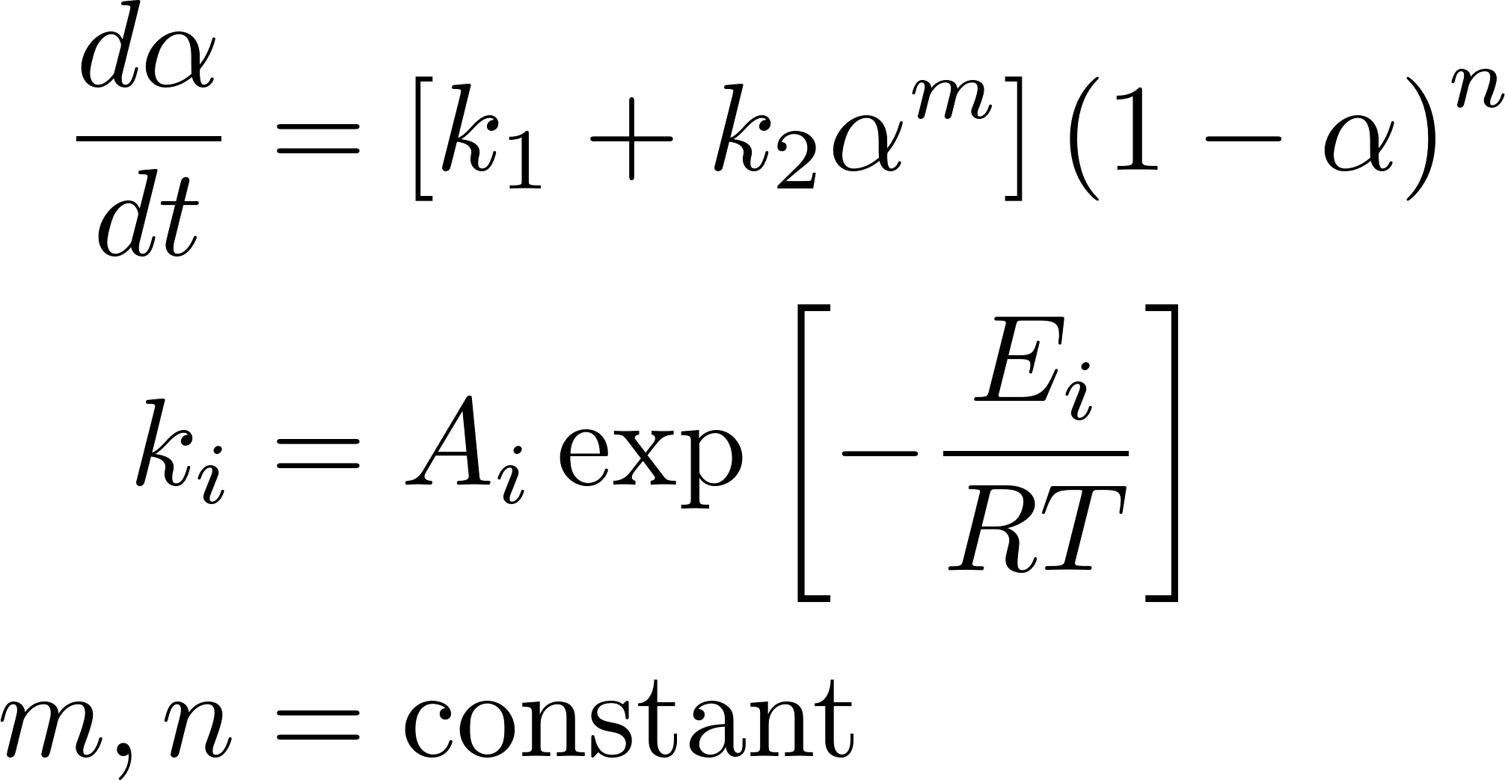
By analyzing the Kamal equation, it becomes clear that, except at very early times, the AEM 2 reaction will proceed at a faster rate than the AEM 1 reaction
T < 27 C
k_{1, AEM 2} < k_{1, AEM 1}
α_{AEM 2} < α_{AEM 1}
Early times
T > 27 C
k_{1, AEM 2} > k_{1, AEM 1}
α_{AEM 2} > α_{AEM 1}
Later times
T > 27 C
k_{1, AEM 2} > k_{1, AEM 1}
k_{2, AEM 2} > k_{2, AEM 1}
α_{AEM 2} > α_{AEM 1}

Slide 23
To perform numerical simulations, we will need following information
Governing equations
Simulation parameters
  Kinetic parameters
  Material properties
Simulation geometry
Problem setup
Lastly, we will look at the results

Slide 24
Analyzing the equations to be solved uncovers the material properties essential for the calculations
Kinetics equation
Energy equation
We now need material properties such as
Density
Specific heat capacity
Thermal conductivity
Heat generation
We have already determined all the
reaction constants for both AEM 1 and AEM 2

Slide 25
Material properties for both AEM 1 and AEM 2
Quantity | Units | AEM 1 | AEM 2
ρ | kg/m³ | 400 | 400
C_{p} | J/(gm-K) | 1.55 | 1.7
k | W/(m-K) | 0.127 | 0.1
ΔH_{g} | J/gm | 1100 | 1200
Source of numbers: Literature, SDS, and in-house measurements

Slide 26
To perform numerical simulations, we will need following information
Governing equations
Simulation parameters
  Kinetic parameters
  Material properties
Simulation geometry
Problem setup
Lastly, we will look at the results

Slide 27
Cylindrical container sizes explored in this study
Volume [mL] | Volume [gal] | Mass [lbs] | Container diameter [inches] | Fill height [inches]
249 | 0.066 | 0.22 | 2.5 | 3.1
11340 | 2.996 | 10 | 9.5 | 9.8
56699 | 14.98 | 50 | 15 | 19.6
124737 | 32.95 | 110 | 20 | 24.2
Assumed density = 400 kg/m³
Source of information: Email from Rajdeep Kalgutkar

Slide 28
We can assume axisymmetric heat transfer and therefore we need to simulate only a certain cross section of this cylinder rather than the whole cylinder
Assume the dynamics of heat transfer is axisymmetric
The dynamics doesn’t change with φ
At a given φ, focus on the cylinder cross-section
φ
R
T = T_{A}
Inner Radius = R
Inside Height = H
Thickness = δ
H
Thickness = δ
H
R

Slide 29
We can further reduce the system since there is a symmetry around the midplane
Thickness = δ
Thickness = δ
H/2
R
H
Symmetry plane
R
Our simulation geometry will
consist of ½ cylinder section

Slide 30
To perform numerical simulations, we will need following information
Governing equations
Simulation parameters
  Kinetic parameters
  Material properties
Simulation geometry
Problem setup
Lastly, we will look at the results

Slide 31
The geometry can be further simplified under the assumption of negligible impact of the container thickness as δ << R, H
φ
φ
r = 0
r = R
r = R + δ
r = 0
r = R
z = H/2 + δ
At any φ neglecting the container thickness δ
z = H/2
z = H/2
δ
R
R
H/2
H/2
T = T_{A}
z
z
r
z = 0
r
z = 0
Assumption of negligible thickness also holds true if
the container thermal conductivity >> AEM thermal conductivity

Slide 32
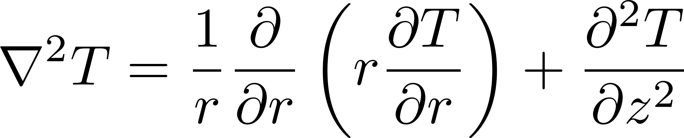
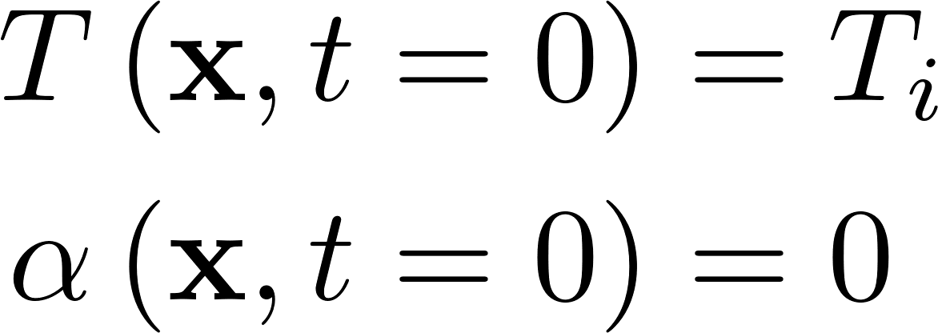
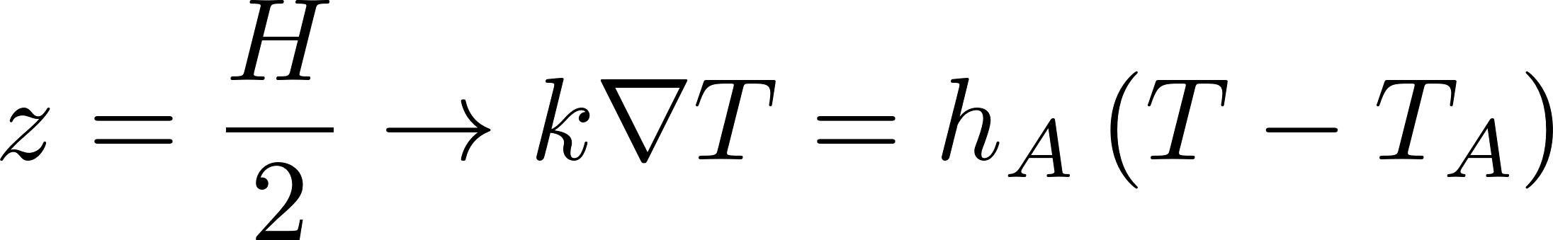
Governing equations, Boundary conditions, and Initial conditions
Governing equations
φ
r = 0
r = R
z = H/2
Initial conditions
R
H/2
Boundary conditions
T = T_{A}
z
Symmetry plane
Container-ambient interface
T = T_{i}
r
z = 0

Slide 33
To perform numerical simulations, we will need following information
Governing equations
Simulation parameters
  Kinetic parameters
  Material properties
Simulation geometry
Problem setup
Lastly, we will look at the results

Slide 34
Before the results, let us compare the material and geometric properties for both cases
Quantity | Units | AEM 1 | AEM 2
ρ | kg/m3 | 400 | 400
C_{p} | J/(gm-K) | 1.55 | 1.7
k | W/(m-K) | 0.127 | 0.1
ΔH_{g} | J/gm | 1100 | 1200
R | meters | 0.0318 | 0.0318
H/2 | meters | 0.0394 | 0.0394
Container Volume | mL | 249 | 249
T_{i} | C | 10 | 10
T_{A} | C | 35 | 35
h_{A} | W/(m²-K) | 5 | 5
A₁ | 1/days | 8.24 × 10¹⁸ | 5.53 × 10⁵⁰
E₁ | J/mol | 129491 | 313271.5
A₂ | 1/days | 5.64 × 10²⁸ | 7.8 × 10¹⁹
E₂ | J/mol | 181686 | 115714.2
m |  | 2.35 | 1.565
n |  | 1.13 | 1.920

Slide 35
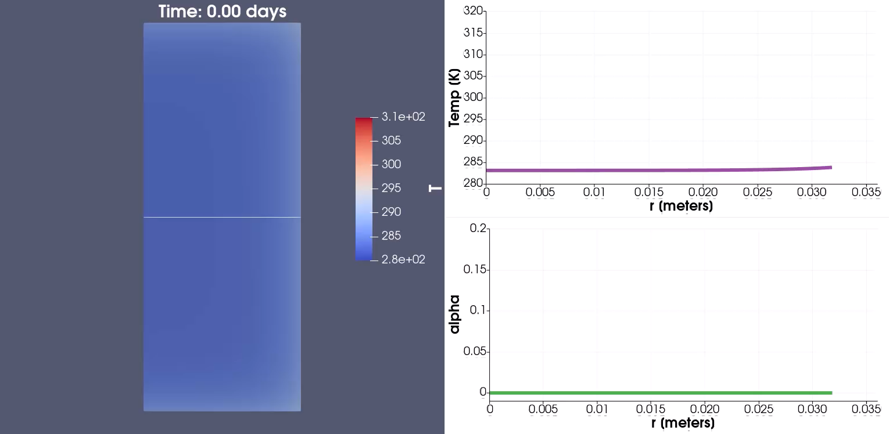
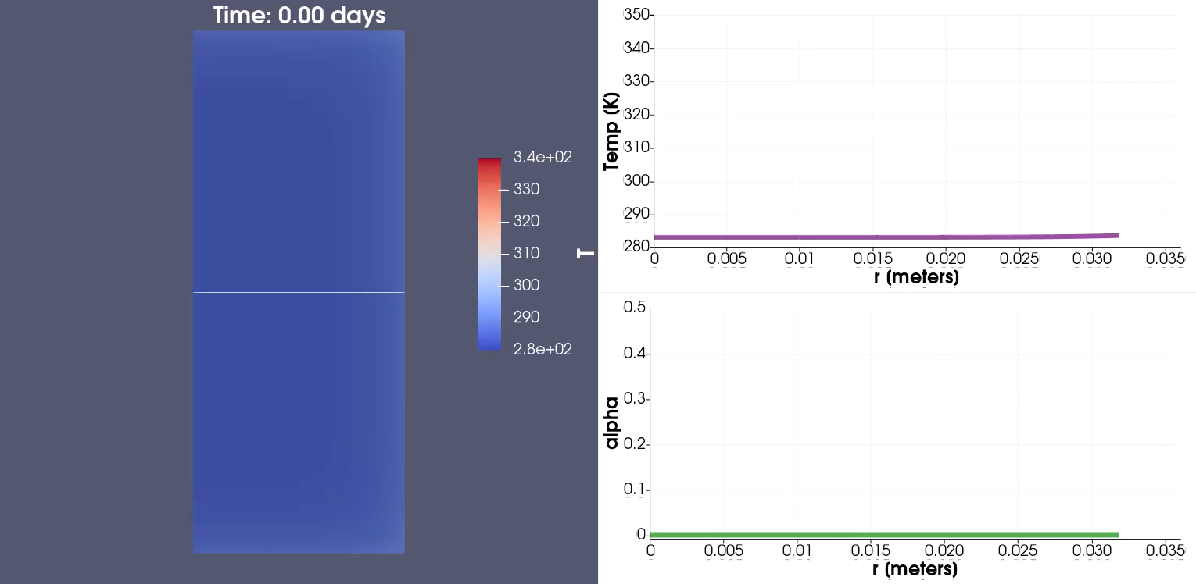
Temperature evolution over time reveals a sharp rise at the center of the cylinder for AEM 2, while it stabilizes to the surrounding temperature for AEM 1
AEM 1
AEM 2
z = H/2
z = 0
r = 0
r = R
Graphs on the right are plotted at the mid-plane, z = 0 for r = 0 to R

Slide 36
To understand this behavior, let us decouple the energy equation from kinetics equation
Initial temperature of both materials = 10 C
Plot the temperature and reaction progress (α) variation with time at the center of the cylinder
We will also assume that the container thicknesses are negligible
For simplicity, we will turn off the heat generation term in the energy equation decoupling the energy equation from the kinetics equation
T_{A} = 35 C
T_{i} = 10 C
0

Slide 37
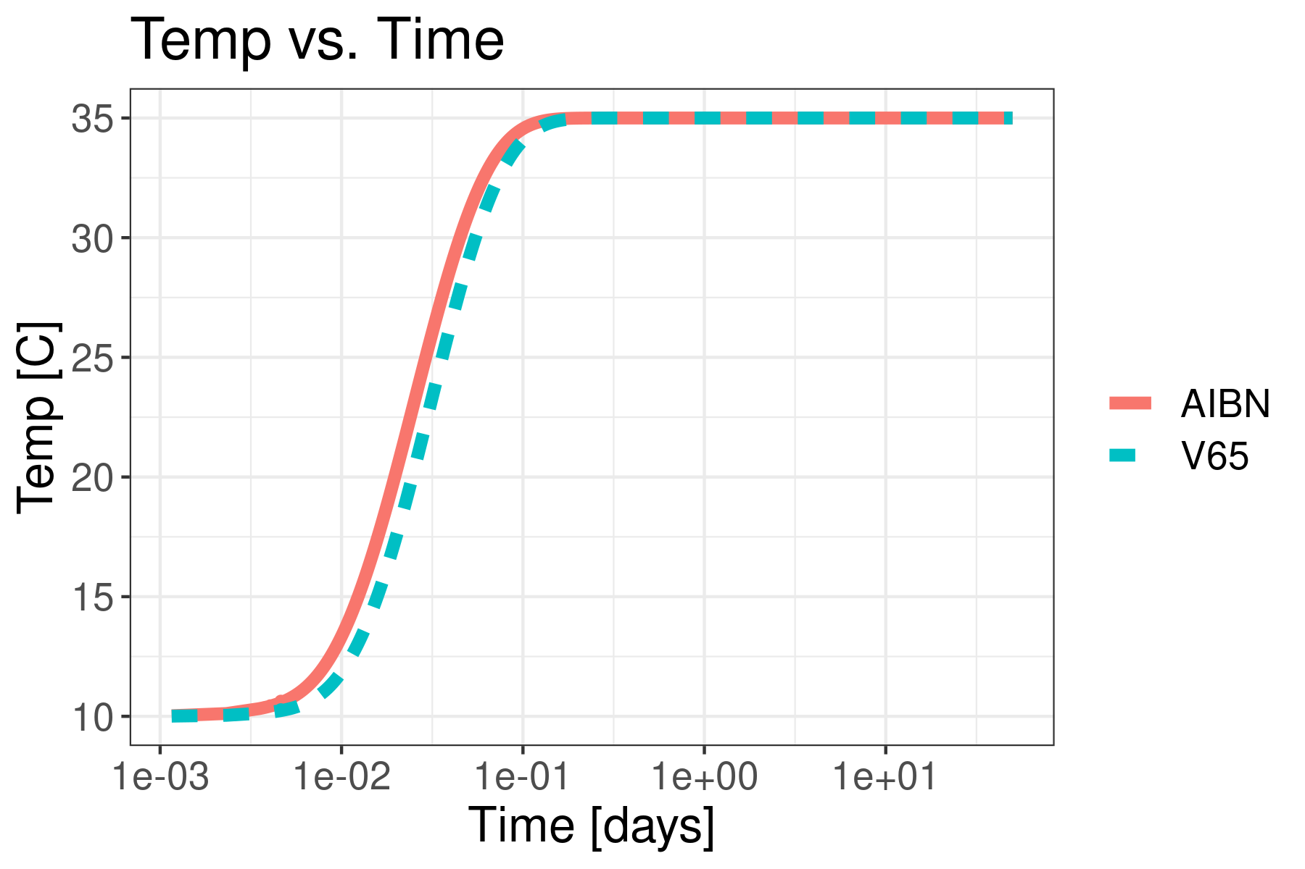
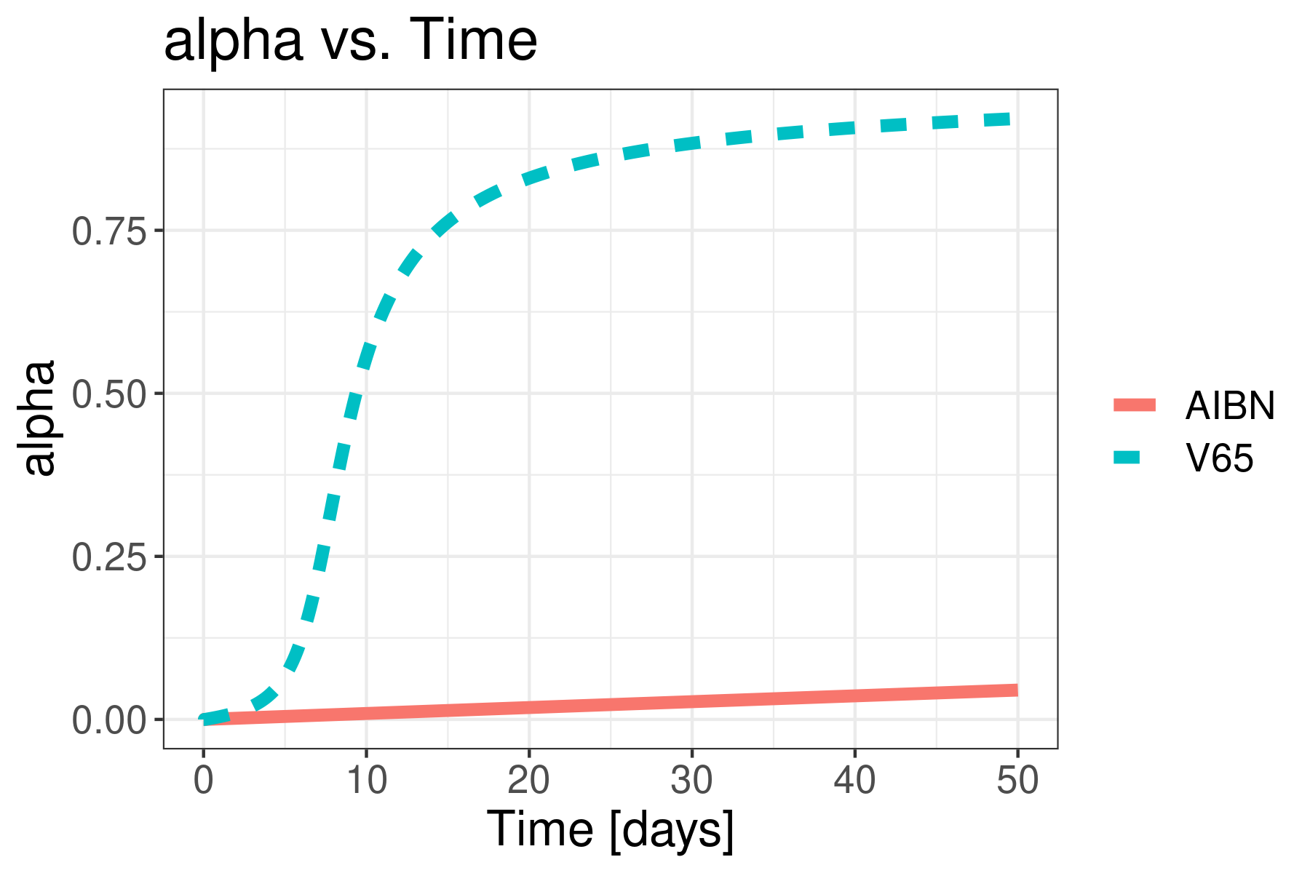
Maximum Temperature variation with time at the cylinder center is almost identical for both containers but they show drastically different behavior with reaction progress
Reaction is almost complete for AEM 2
α
AEM 1
α
AEM 1
AEM 2
AEM 2
Temp here corresponds to maximum
temperature inside the container

Slide 38
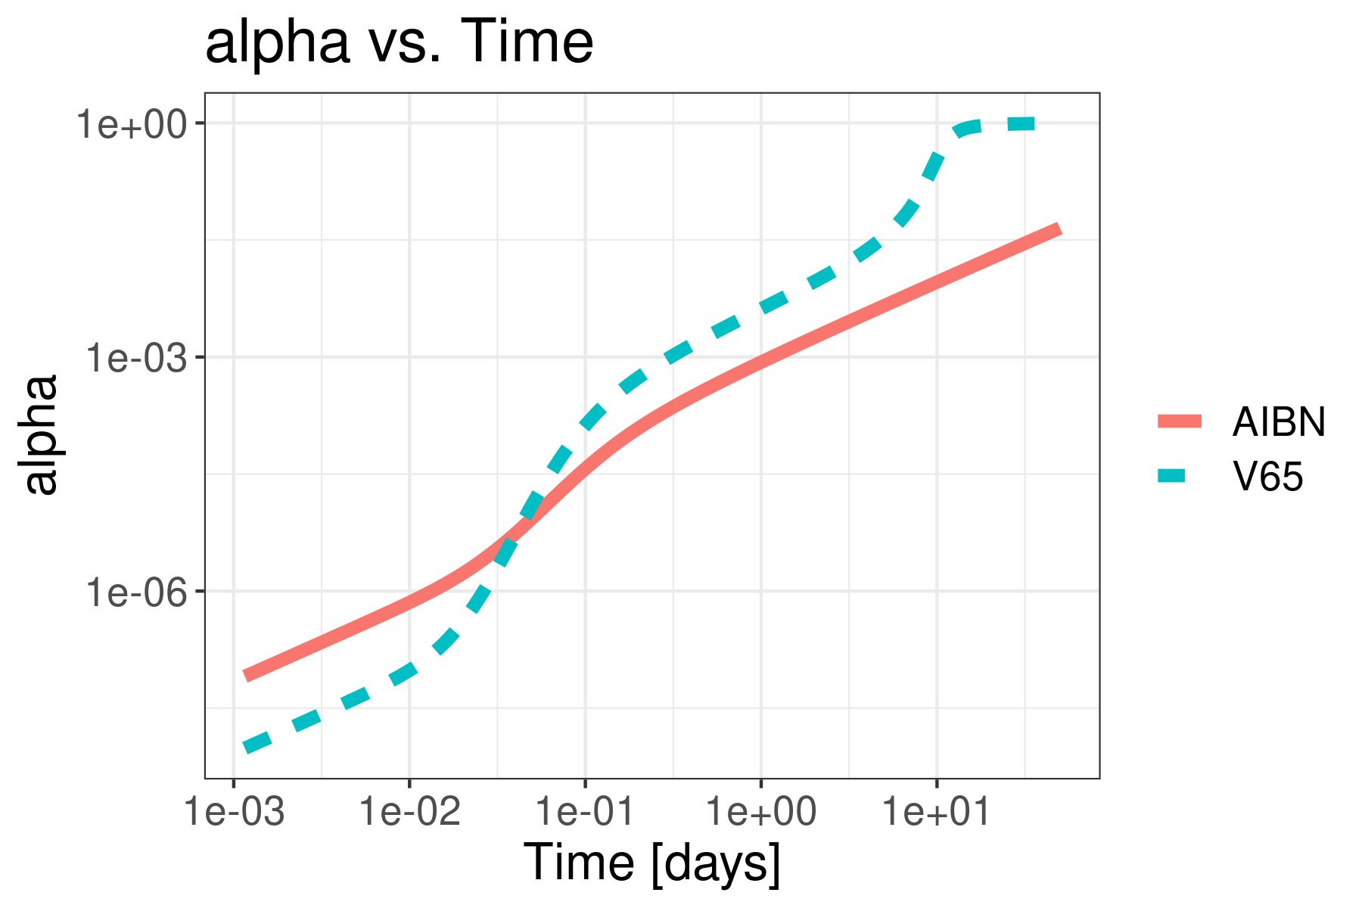
Note that at time ≈ 0.05 days when the temperature reaches ≈ 27 C, the reaction progress is identical for both materials
For T < 27 C, α_{AEM 2} < α_{AEM 1}
For T > 27 C, α_{AEM 2} > α_{AEM 1}
These graphs clearly shows that AEM 2 kinetics proceeds faster than AEM 1
α
AEM 1
α
AEM 1
AEM 2
AEM 2
Temp here corresponds to maximum
temperature inside the container

Slide 39
How does this behavior change when heat generation term is included in the analysis?

Slide 40
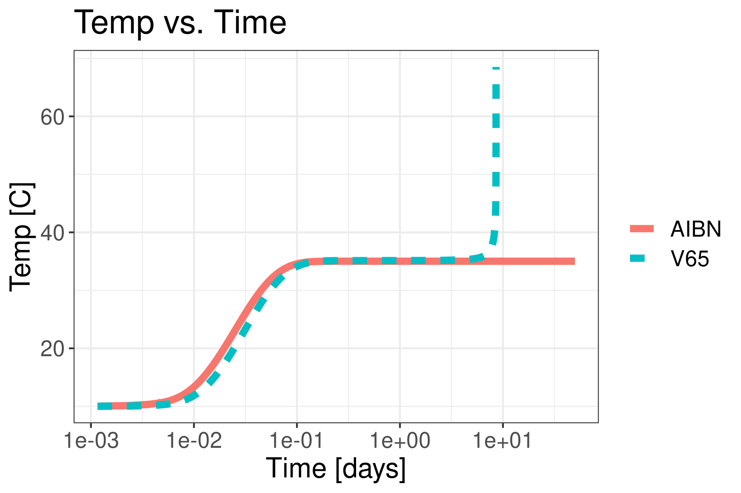
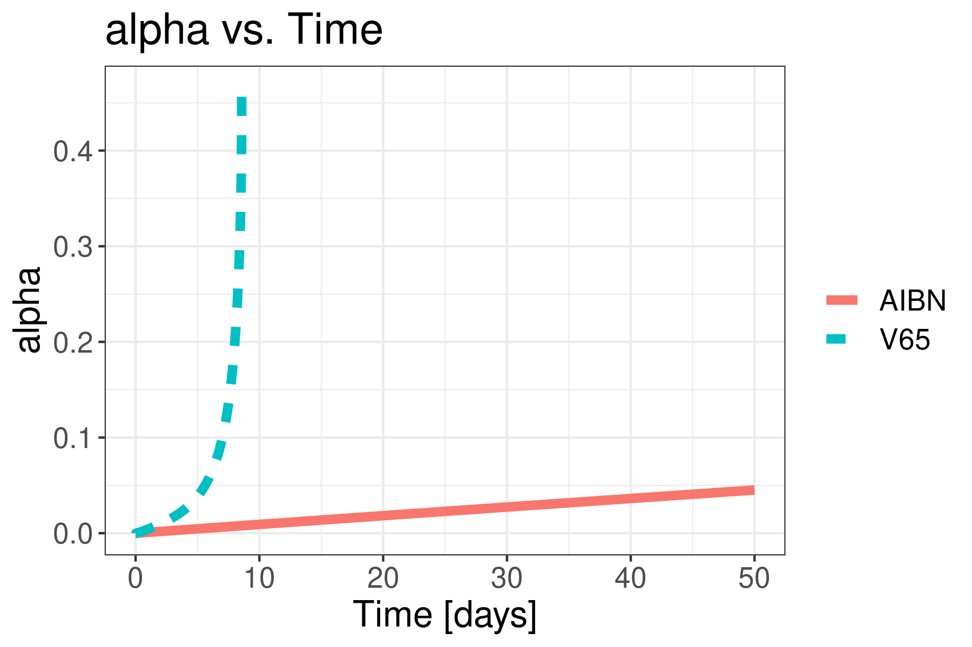
When the heat generation term is included in the analysis, the AEM 2 reaction accelerates whereas AEM 1 reaction does not accelerate
Temperature variation is similar to no heat generation case before until time ≈10 days
But with dα/dt, included in the energy equation, the temperature shoots up for AEM 2
α
AEM 1
α
AEM 1
AEM 2
AEM 2
We expect SADT to be lower for AEM 2 than AEM 1 on account of faster kinetics
Temp here corresponds to maximum
temperature inside the container

Slide 41
Let us look at the different cases we will need to analyze to estimate SADT – study different container sizes and different T_{A}
Quantity | Units | AEM 1 | AEM 2
ρ | kg/m3 | 400 | 400
C_{p} | J/(gm-K) | 1.55 | 1.7
k | W/(m-K) | 0.127 | 0.1
ΔH_{g} | J/gm | 1100 | 1200
T_{i} | C | 10 | 10
T_{A} | C | Vary
Container Volume | mL | 249, 11340, 56699, 124737
A₁ | 1/days | 8.24 × 10¹⁸ | 5.53 × 10⁵⁰
E₁ | J/mol | 129491 | 313271.5
A₂ | 1/days | 5.64 × 10²⁸ | 7.8 × 10¹⁹
E₂ | J/mol | 181686 | 115714.2
m |  | 2.35 | 1.565
n |  | 1.13 | 1.920

Slide 42
We will monitor three more quantities when evaluating SADT
time for the temperature to reach T_{A} - 2 = Clock Starts = CS
time to reach T_{A} + 6 after temperature has reached T_{A} - 2 = Clock Ends = CE
time difference between CE and CS
Max Temperature = T in degree C
Clock Starts = CS
T = T_{A}+6
Ambient temp
in the oven = T_{A}
T = T_{A}-2
Clock Ends = CE
Time

Slide 43
Comparison of SADT values shows that AEM 2 has a lower SADT than AEM 1, with AEM 2 SADT unaffected by container size due to its faster kinetics
Mass(lb) | Volume [mL] | SADT [C] | Time in days to reach T_{A} - 2 [C] = CS | CE - CS [days] | Material
0.22 | 249 | 59 | 0.08 | 6.4 | AEM 1
10 | 11340 | 54 | 0.48 | 4.8 | AEM 1
50 | 56699 | 49 | 1.11 | 2.2 | AEM 1
110 | 124737 | 46 | 1.75 | 2.5 | AEM 1
0.22 | 249 | 36 | 0.08 | 6 | AEM 2
10 | 11340 | 34 | 0.59 | 5.6 | AEM 2
50 | 56699 | 33 | 1.43 | 4.6 | AEM 2
110 | 124737 | 32 | 2.32 | 5.5 | AEM 2

Slide 44
For AEM 1, the slow reaction kinetics makes container size a significant factor, primarily due to the surface area-to-volume ratio of the container
Small containers lose heat easily in comparison to the generated heat as compared to the big containers
Higher surrounding temperature needed for small containers for the reaction to take off –
leading to higher SADT
Volume = 249 mL
D = 2.5 inches
H = 3.1 inches
Surface Area/Volume = 75.69
Volume = 11340 mL
D = 9.5 inches
H = 9.8 inches
Surface Area/Volume = 20.59
Volume = 56699 mL
D = 15 inches
H = 19.6 inches
Surface Area/Volume = 12.51
Volume = 124737 mL
D = 20 inches
H = 24.2 inches
Surface Area/Volume = 9.5

Slide 45
Takeaway message
Big packages
Low SADT
Takes more time to reach T_{A}-2
Small packages
High SADT
Takes less time to reach T_{A}-2

Slide 46
Consequences of differences in SADT and associated time scales
On the factory floor, although the SADT is lower, the reaction takes longer to reach hazardous levels. During this time, the material is typically consumed, refrigerated, or the surrounding temperature naturally decreases (often due to the onset of night).
In laboratory settings, while there is less time to respond, the small size sample is less likely to be exposed to high temperatures (e.g., 36°C for AEM 2), unless placed near an oven or if the building’s HVAC system fails.
Due the less likelihood of occurrence of these extreme scenarios,
we have not seen any unfortunate incidences

Slide 47
Summary
The model was developed based on a coupled system of differential equations, incorporating the Kamal equation for reaction kinetics and an energy equation for temperature, to analyze the behavior of AEMs in containers of varying sizes.
Reaction parameters were derived by fitting differential scanning calorimetry (DSC) data from the literature for two materials, AEM 1 and AEM 2.
Material properties for both compounds were sourced from the literature.
These material properties, along with reaction kinetics parameters, container dimensions, initial temperatures, and surrounding temperatures, were input into the model.

Slide 48
Conclusions
Faster-kinetics AEMs → weak sensitivity of SADT to container size, lower SADT
Larger containers → lower SADT, slower progression to hazard
Smaller containers → higher SADT, faster progression to hazard
Container size ↑ → SADT ↓ (consequence of surface area to volume ratio)

Slide 49
Backup section

Slide 50
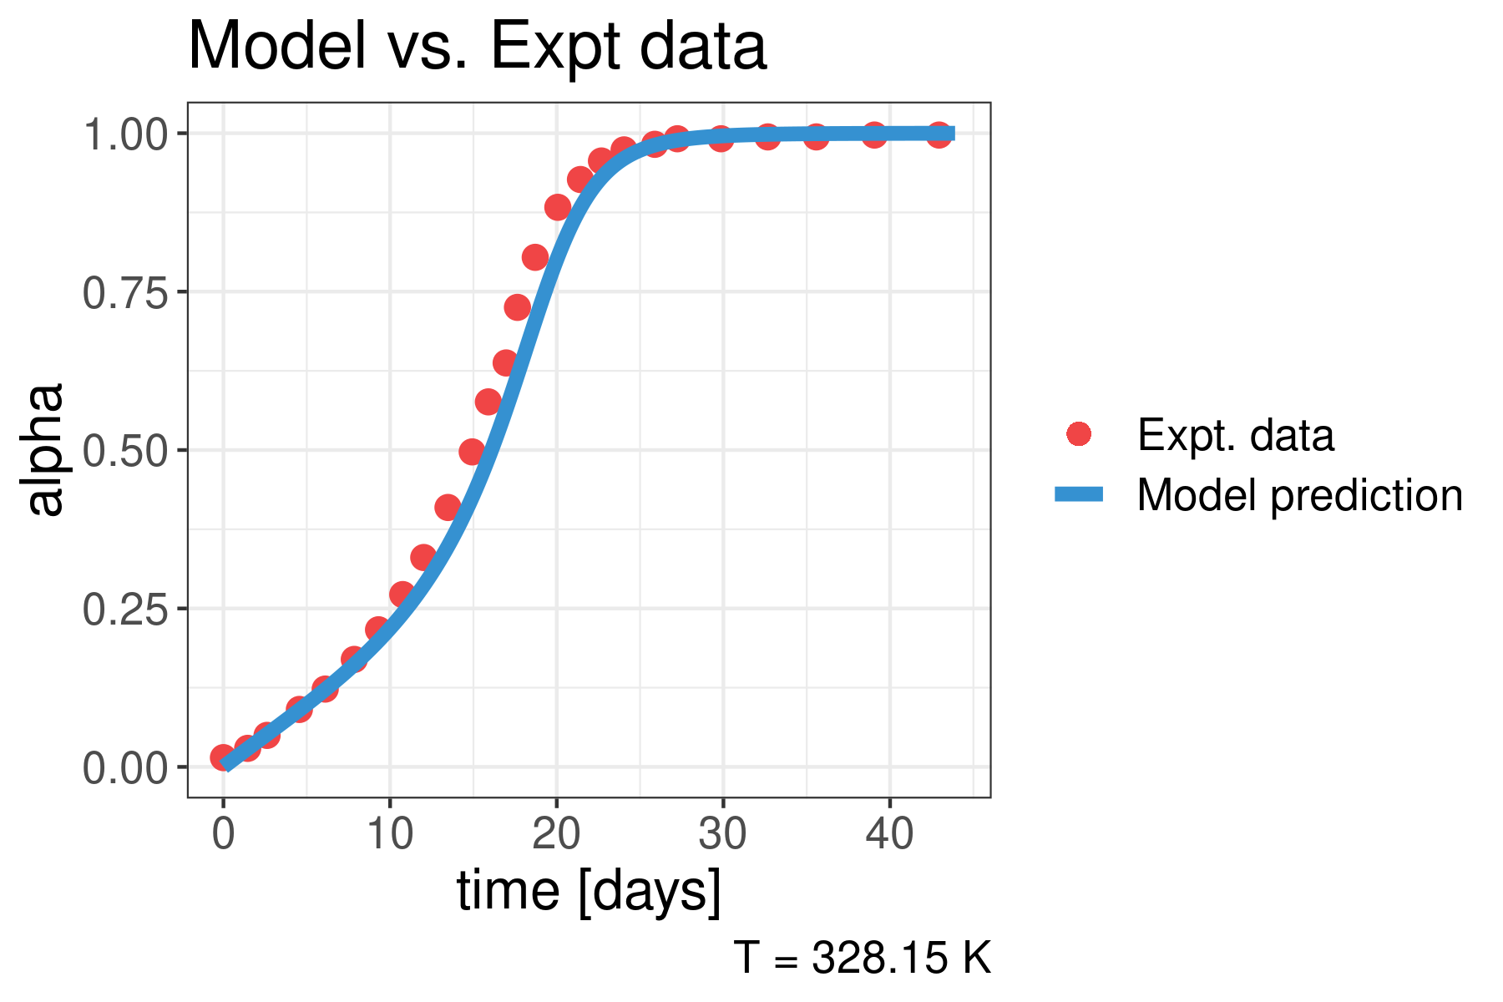
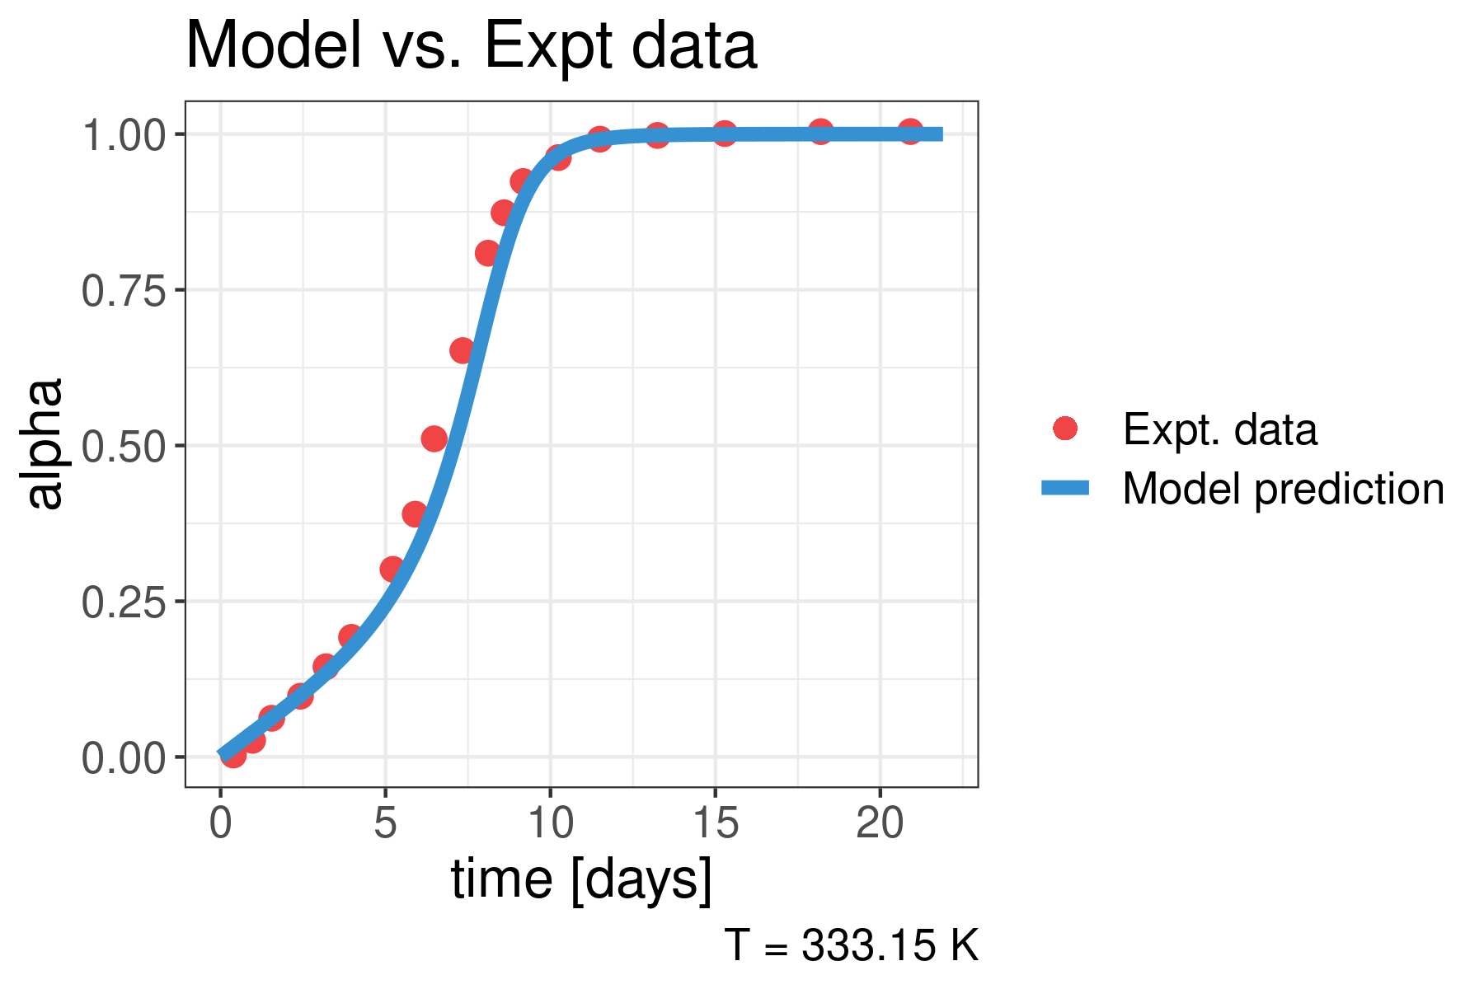
The model fit agrees well with the experimental data from the paper at 55 C and 60 C and captures both early times and late times kinetics well

Slide 51
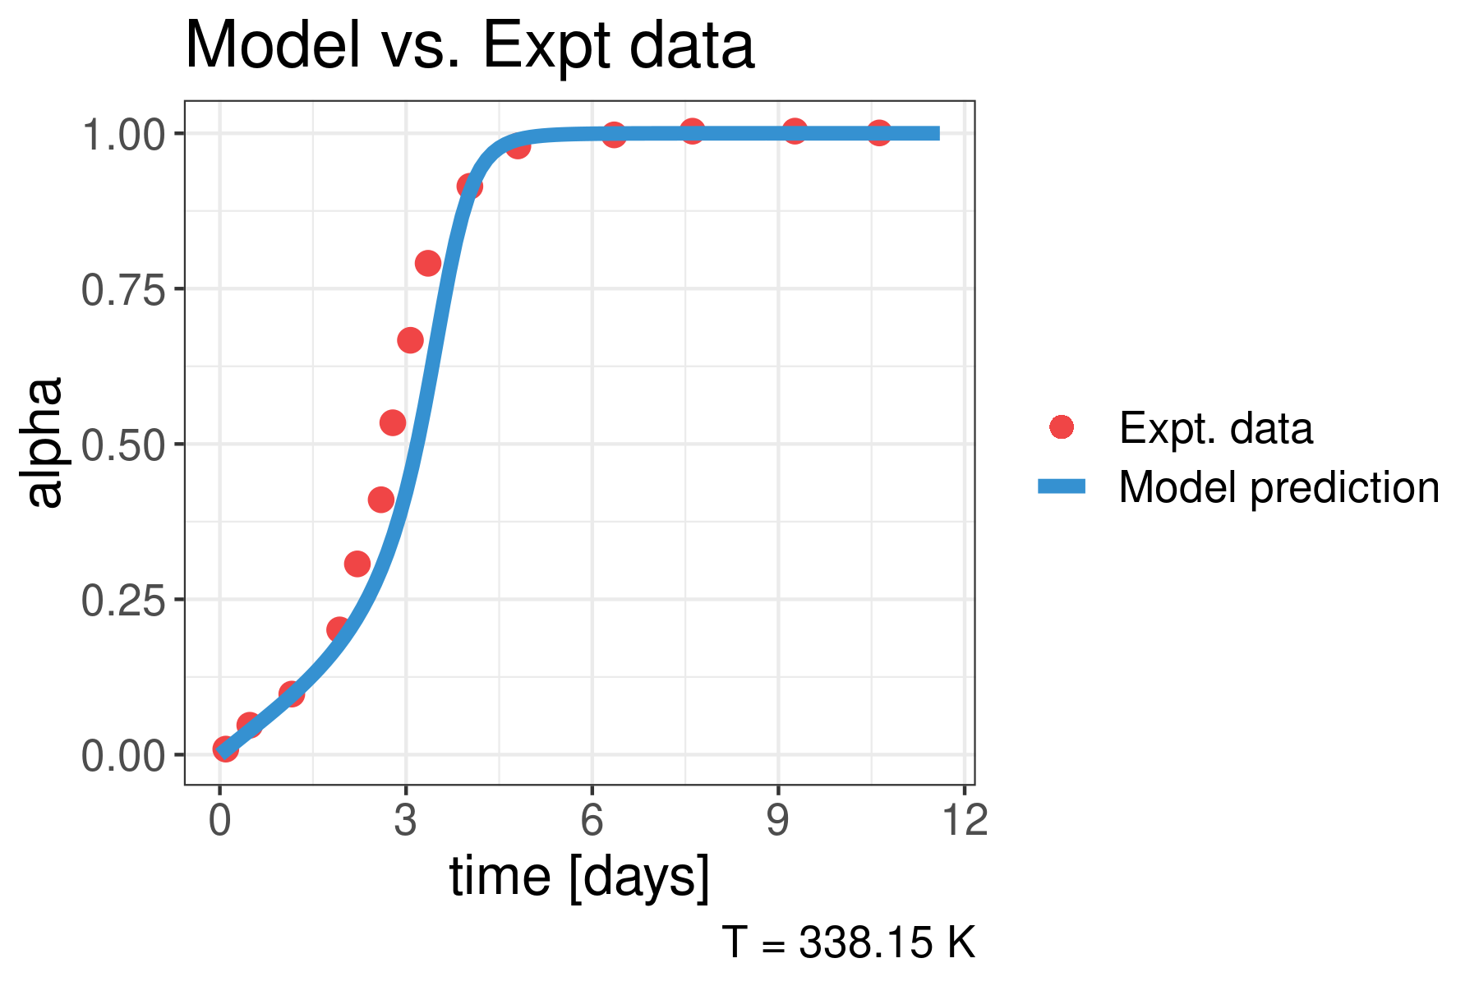
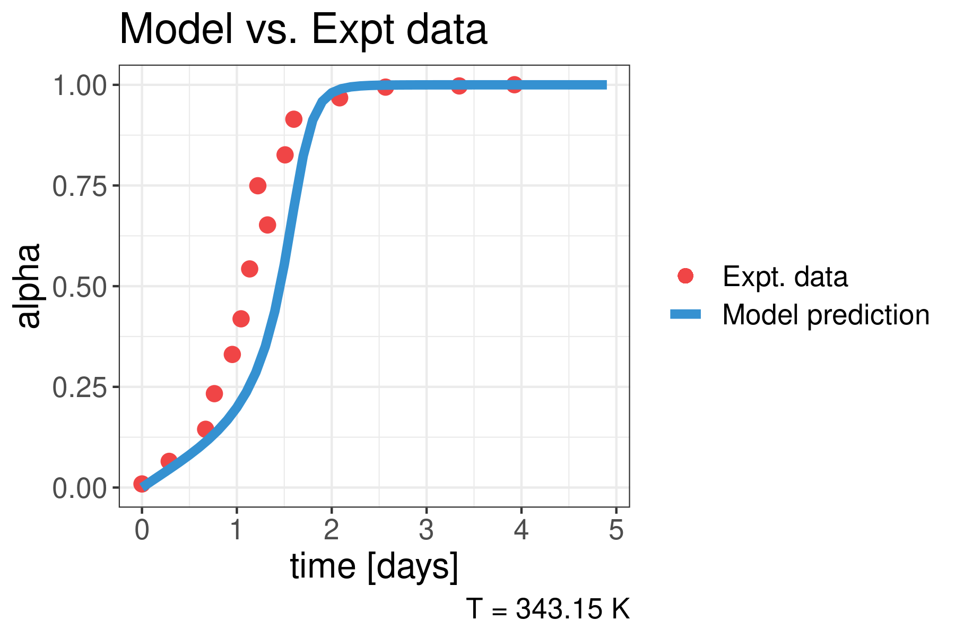
The model fit agrees well with the experimental data from the paper at 65 C and 70 C and captures both early times and late times kinetics well

